Slide 1
Intro to Booting With Spring
https://dzone.com/articles/newbies-intro-booting-with-spring
Department
Date

Slide 2
XTX

Slide 3
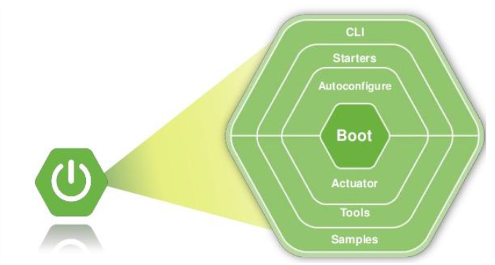
Spring Boot
Spring Boot is built on top of Spring modular framework and takes care of CLI (command line interface), bootstrapping, dependencies, framework integrations, testing, tools, auto-configuration, and actuators.

Slide 4
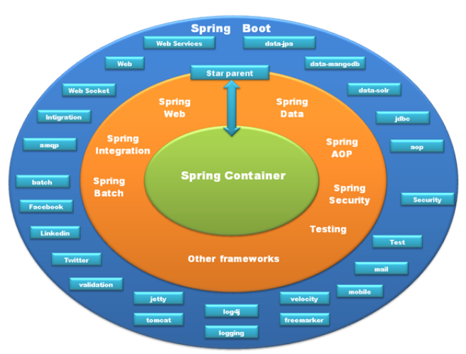
Spring Boot
Spring Boot encapsulates Spring and many other frameworks and tools, like Apache Velocity, Log4j, and Tomcat, and provides starters to take care of these framework and tool integrations.
The spring-boot-starter-parent root module hooks your application with Spring Boot; and the rest of the starter modules can be included as needed.

Slide 5
Spring Boot – Maven Build
Spring Boot is the easiest recommended way to setup your Spring application environment. You just need to choose one of the ways to initialize your Spring application.
Spring Boot supports Ant, Maven, and Gradle build systems, including traditional building methodology. Simply dump Spring libraries in the application class path. Maven and Gradle are the recommended ways to build your project.
Spring libraries follow naming conventions, Spring Boot’s jar name starts with spring-boot-*.jar and the Spring Framework’s jar name starts with spring-*.jar.
Spring applications are configured to inherit Maven pom with spring-boot-starter-parent, it is an excellent way to start with the Spring platform. Any one of these options can be used to configure your Spring Boot Application.
Applications may have Spring Boot or any other dependencies which can be configured in the <dependencies> section of the application pom.
Spring Boot takes care of dependency management of the underlying Spring Framework, Spring Cloud, Spring Integration, and any other dependencies of the Spring platform as per your configuration.
Java does not provide any standard way to wrap the external application jars, configurations, and entities required. spring-boot-mavenp-plugin solves this problem by wrapping your application in an executable jar, also known as a fat jar.

Slide 6
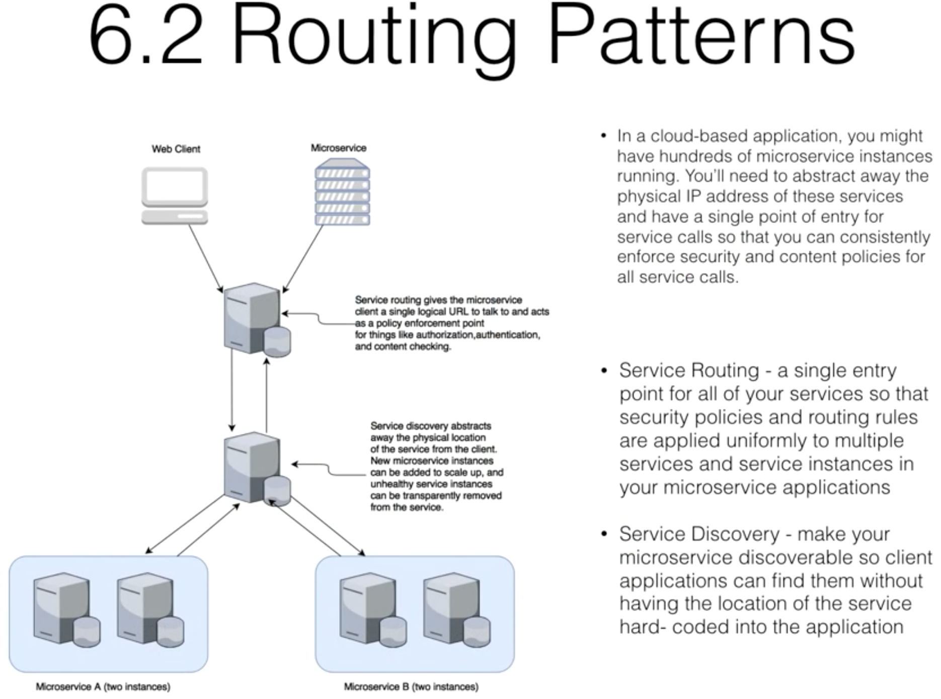
Microservices – Spring Boot

Slide 7
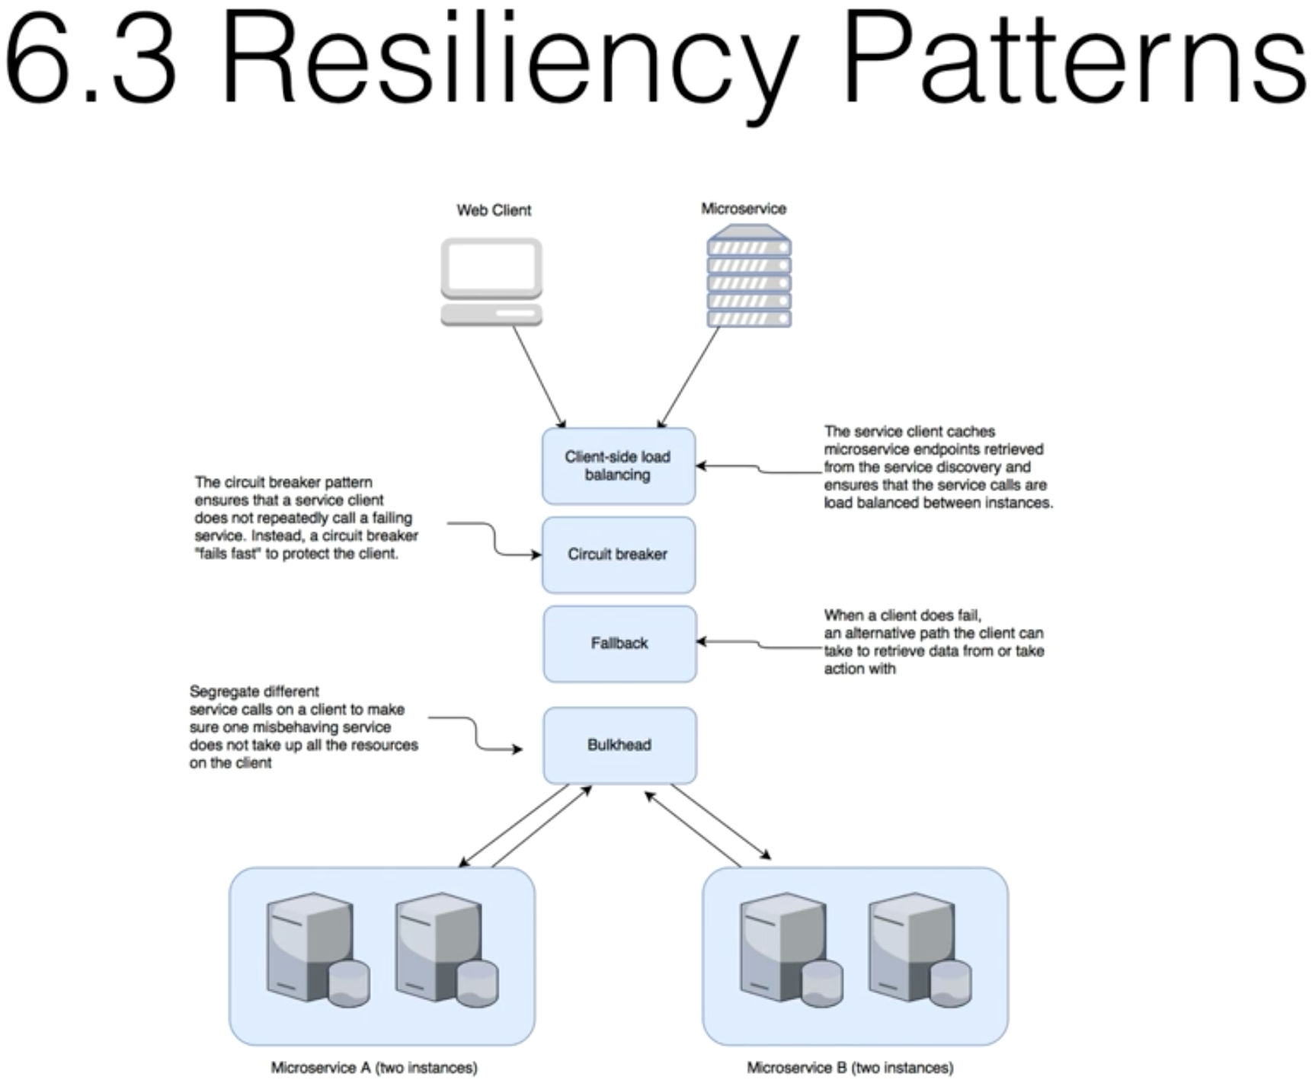
Microservices – Spring Boot

Slide 8
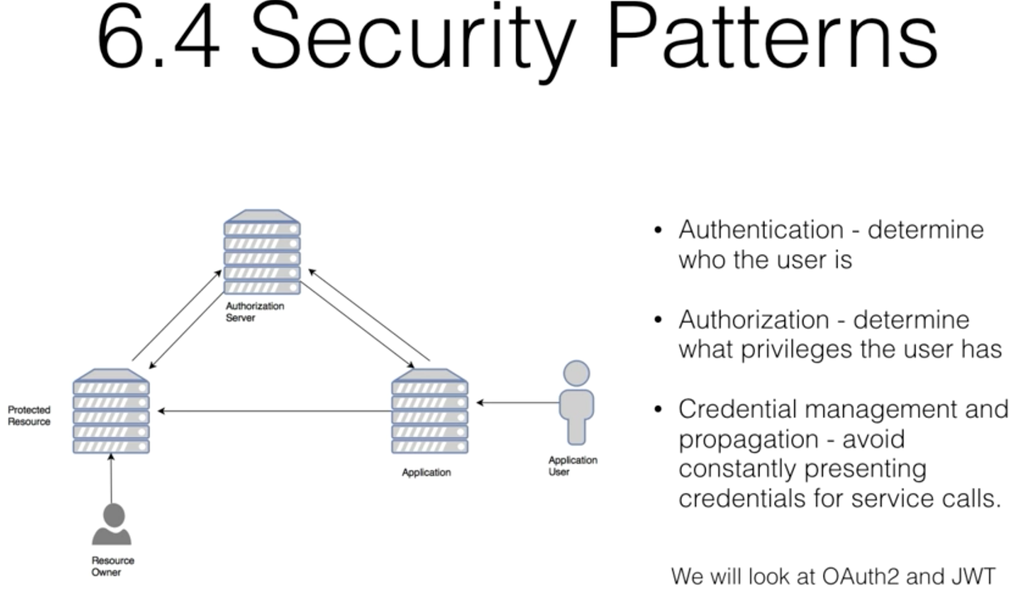
Microservices – Spring Boot

Slide 9
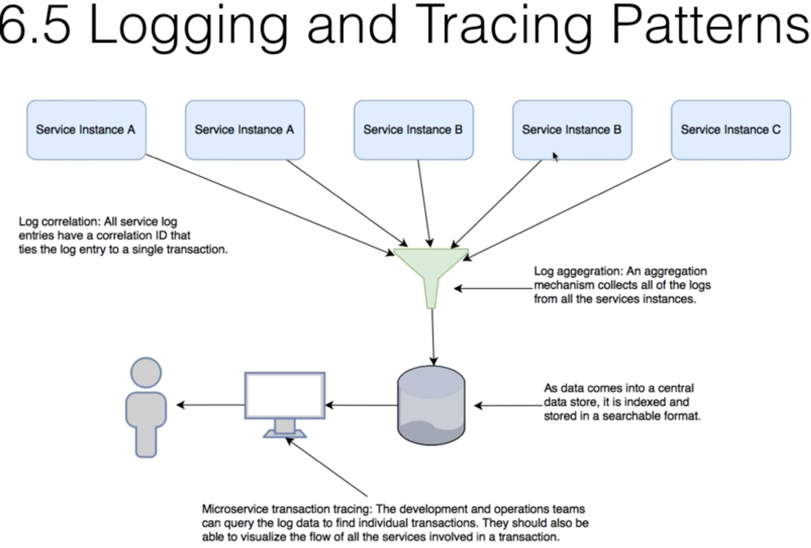
Microservices – Spring Boot

Slide 10
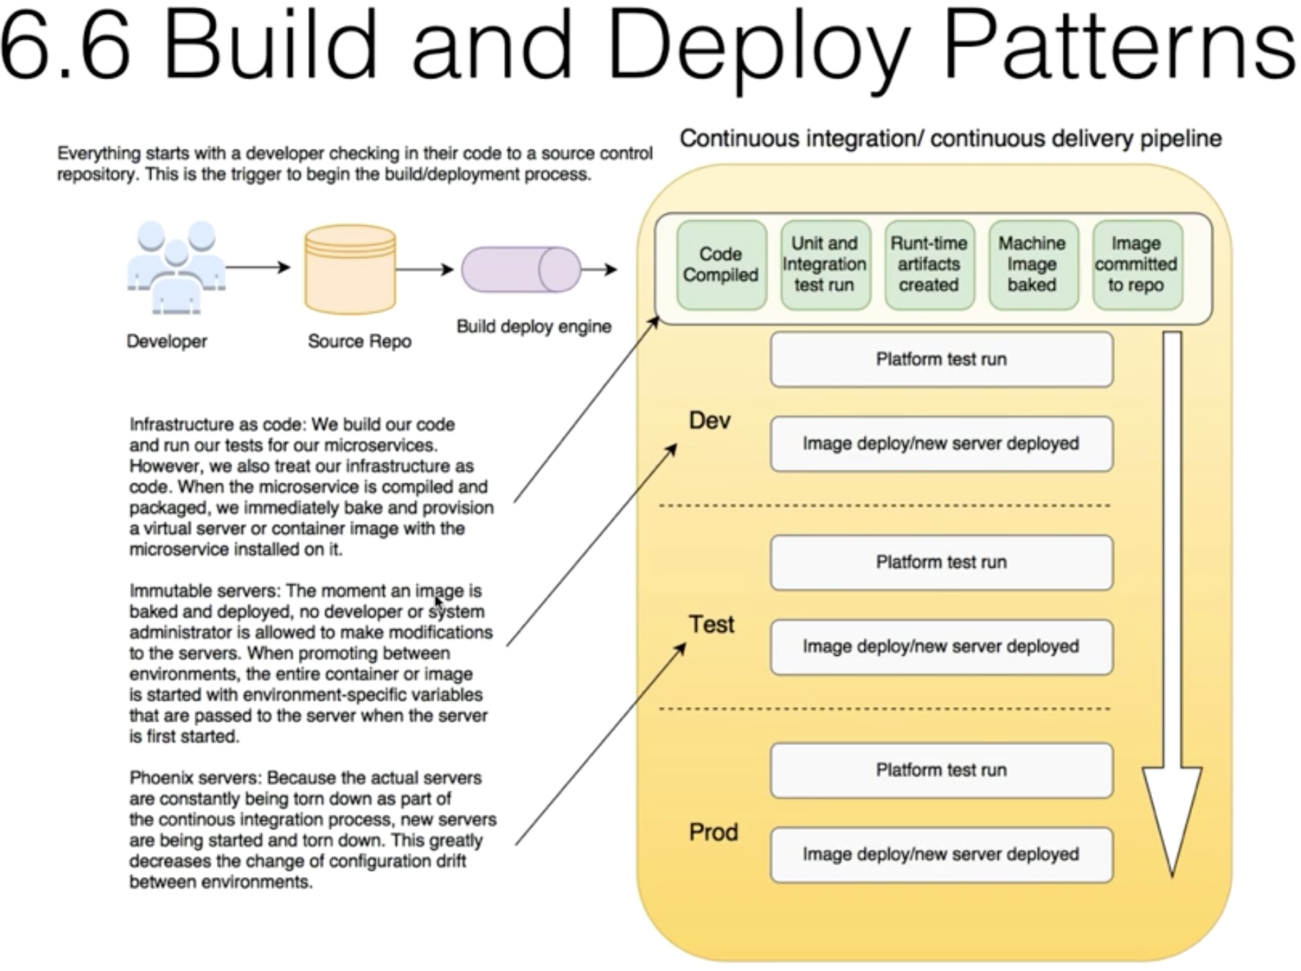
Microservices – Spring Boot

Slide 11
Microservices – Spring Boot

Slide 12
XTX

Slide 13
XTX

Slide 14
XTX

Slide 15
To save this presentation as your default PowerPoint template:
Spring framework is layered architecture, which allows you to be selective about which of its components you use. Spring is a cohesive framework for J2EE application development.
Spring Boot is developed on top of the Spring Framework; it’s a modular framework which helps in building application infrastructure, taking care of CLI (command line interface), bootstrapping, dependencies, framework integrations, testing, tools, auto-configuration, and actuators.

